Slide 1
Eﬃcient deep network for vision-based object detection in robotic applications
keyu Lu, Xiangjing An, Jian Li, Hangen He Neurocomputing 245 (2017) 31–45
รัชกฤช มัญยานนท์ |รหัสนักศึกษา 6014450017
1

Slide 2
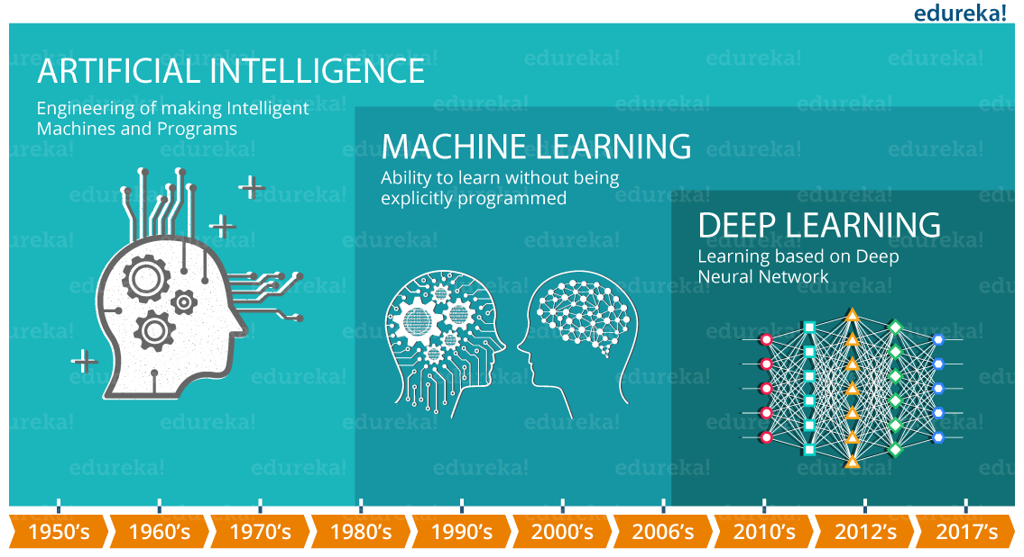
Introduction Deep learning
2

Slide 3
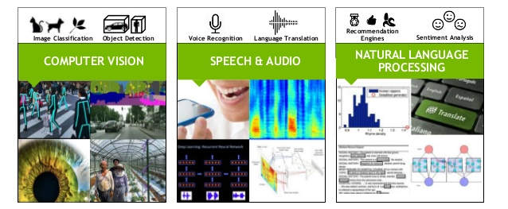
Introduction Deep learning
3

Slide 4
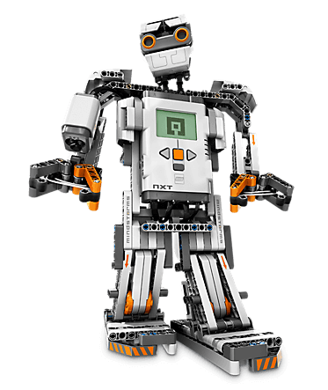
Abstract
Vision-based object detection is essential for robotic.
Strict constraints that apply to many robot systems in terms of run-time, power and space. To meet these special requirements of robotic applications.
4

Slide 5
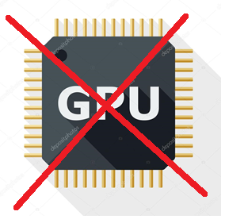

Abstract
The motivation of this paper is to reduce the run-time of CNN based object detection system and make it possible to be utilized in robotic applications without GPU support.
5

Slide 6
Abstract
Introduce proposal layer to eﬃciently generate potential object bounding-boxes.
Construct a robust detection layer which contains a multiple population genetic algorithm-based convolutional neural network (MPGA-based CNN) module and TLD-based multi-frame fusion procedure.
6

Slide 7
Introduction
Vision-based object detection
Hand-craft solutions
HOG+SVM
Viola and Jones
SIFT
Deep learning solutions
Data Driven
CNN Based
7

Slide 8
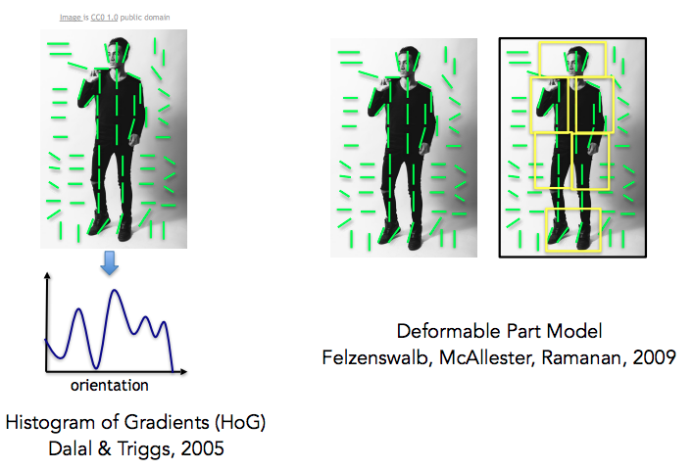
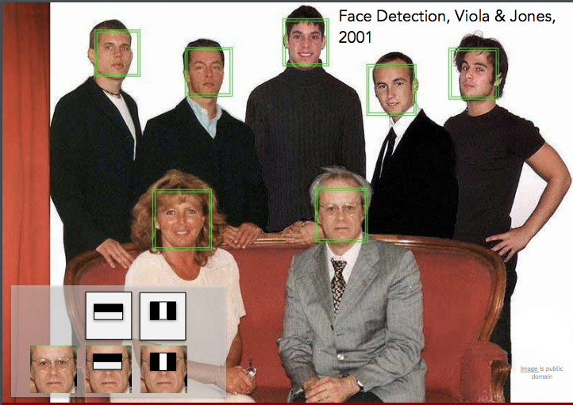
Hand Craft Solution
8

Slide 9
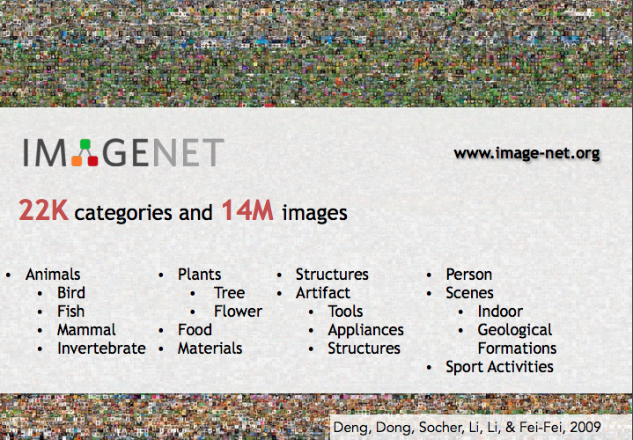
9

Slide 10
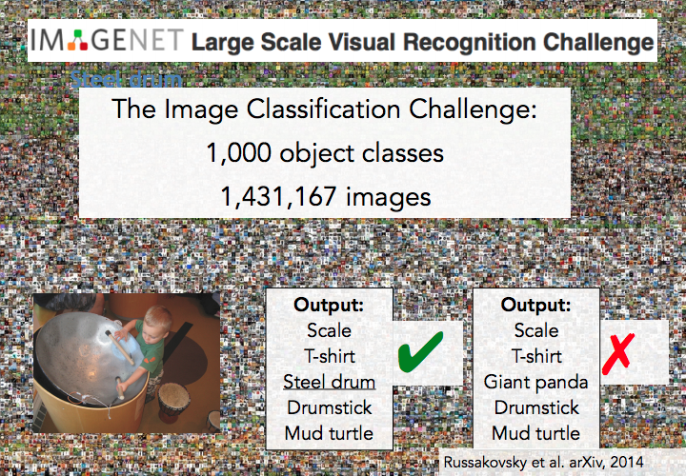
10

Slide 11
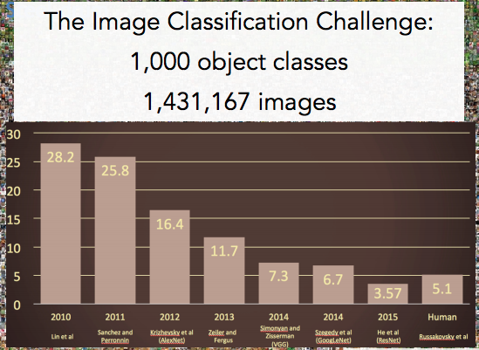
11

Slide 12
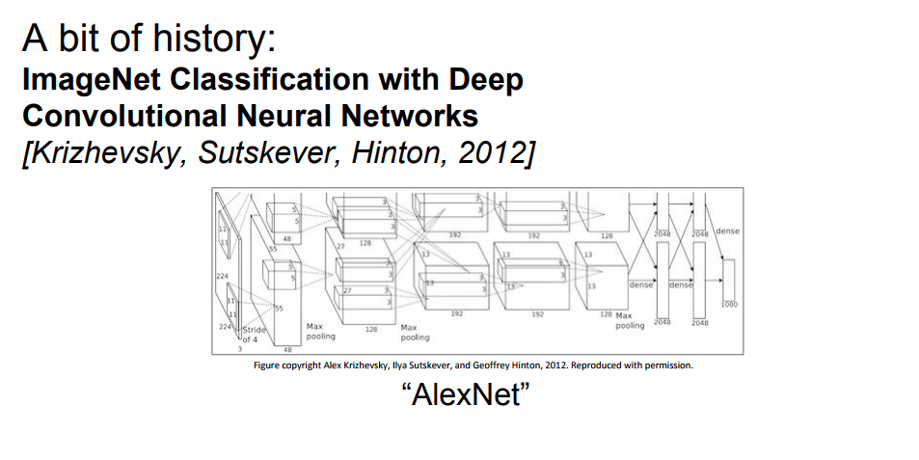
12

Slide 13
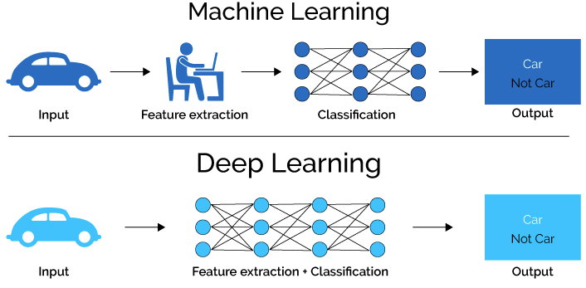
Introduction Deep learning
13

Slide 14
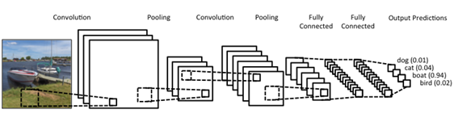
Type of Layer on CNN Deep Learning
Fully Connected Layer
Convolution Layer
Pooling layer
14

Slide 15
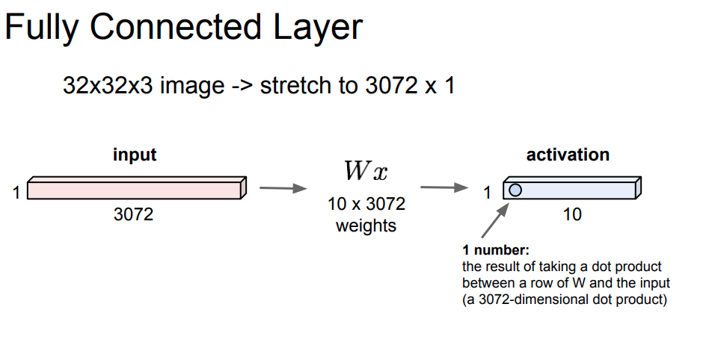
15

Slide 16
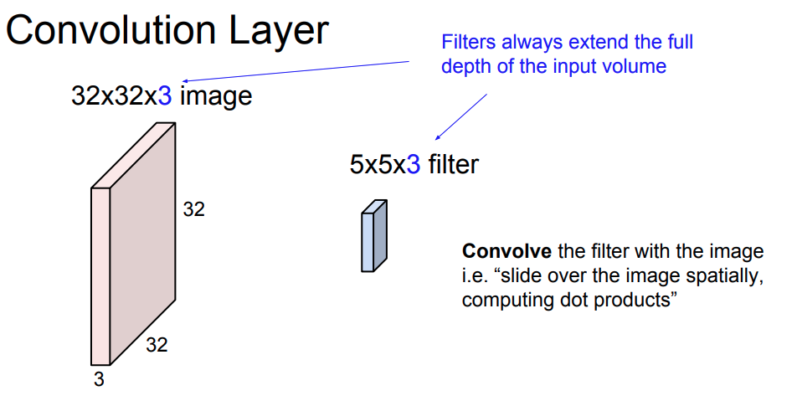
16

Slide 17
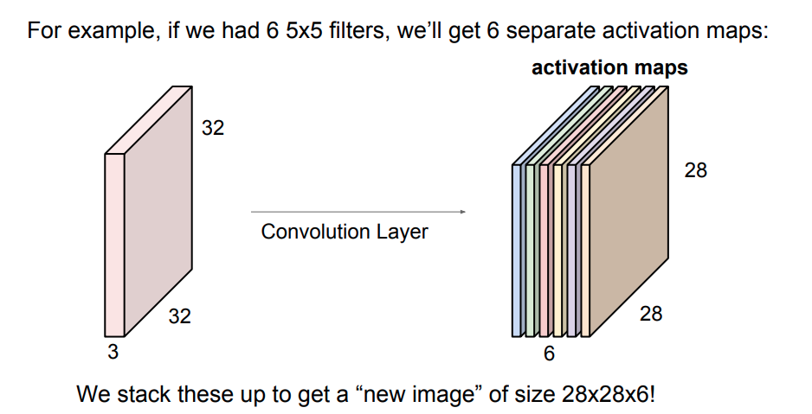
17

Slide 18
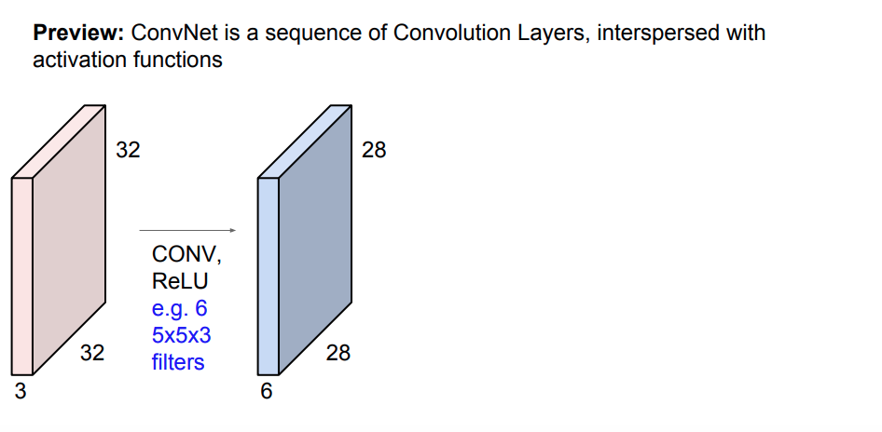
18

Slide 19
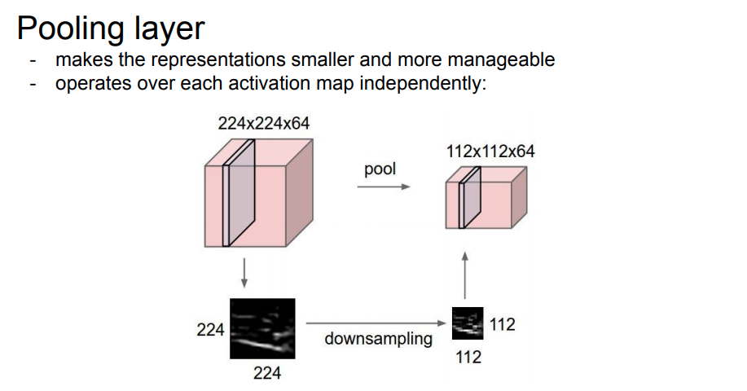
19

Slide 20
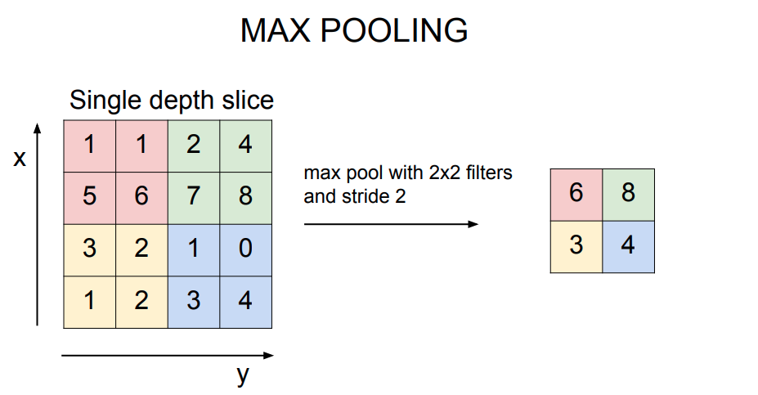
20

Slide 21
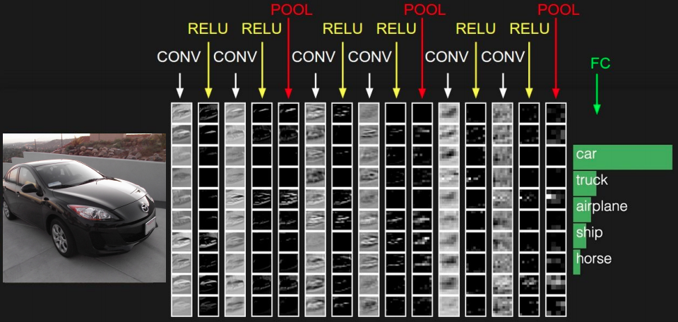
21

Slide 22
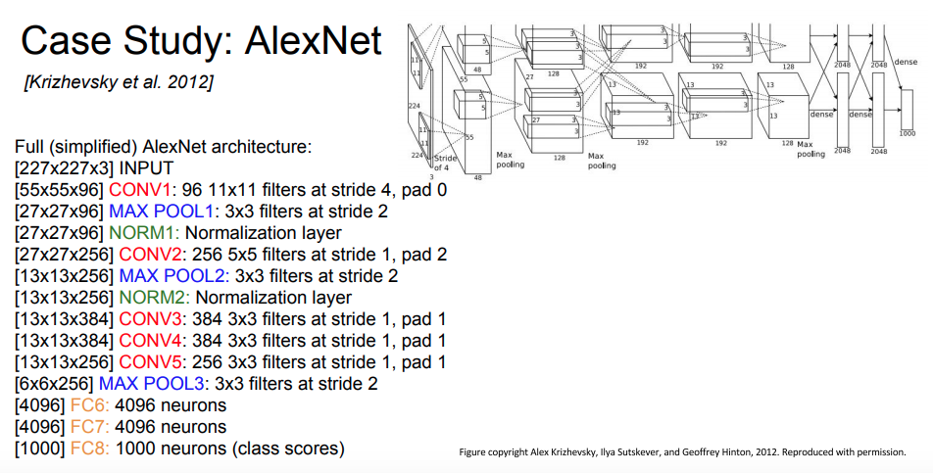
22

Slide 23
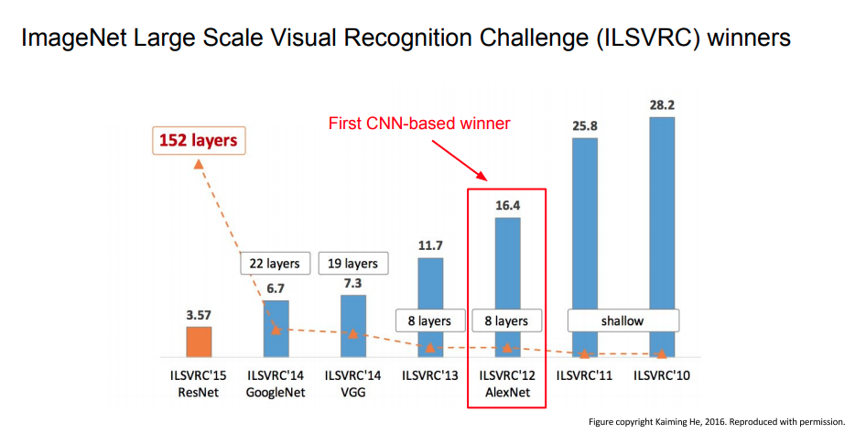
23

Slide 24
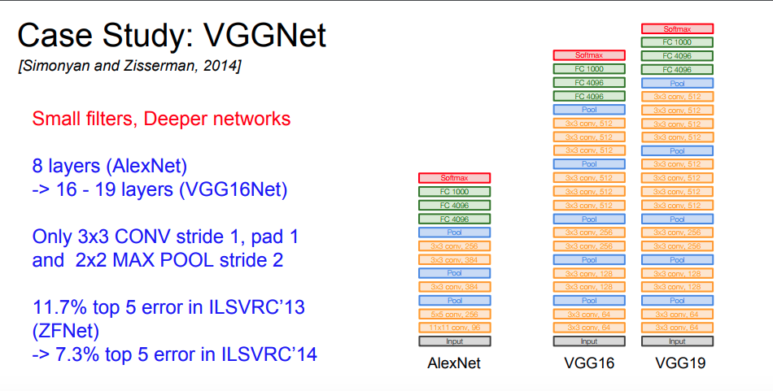
24

Slide 25
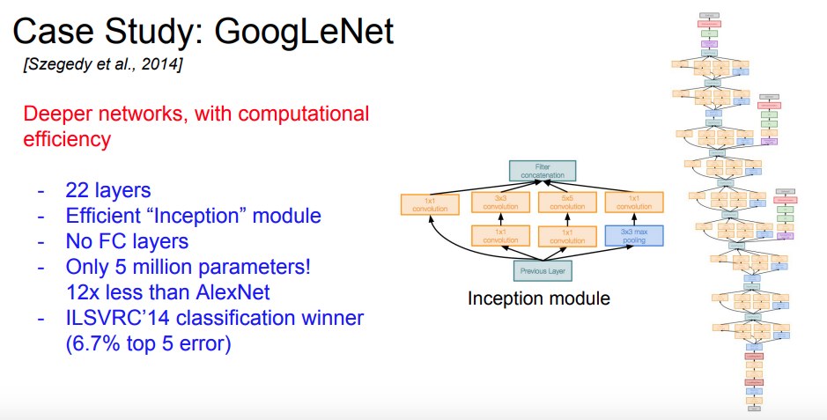
25

Slide 26
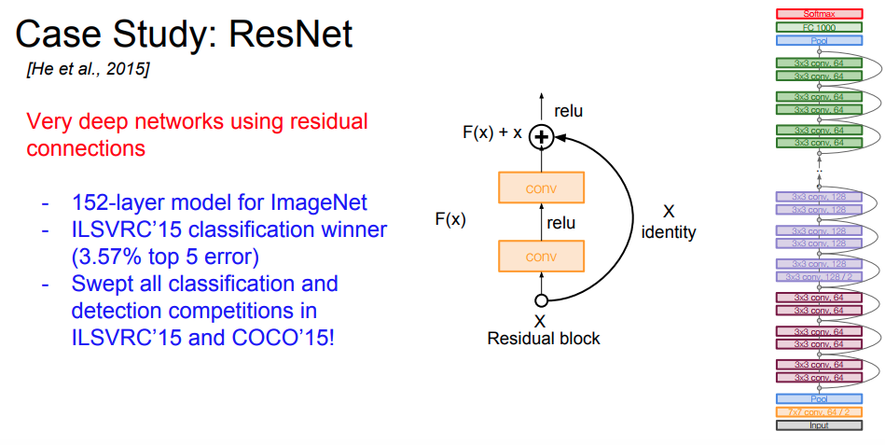
26

Slide 27
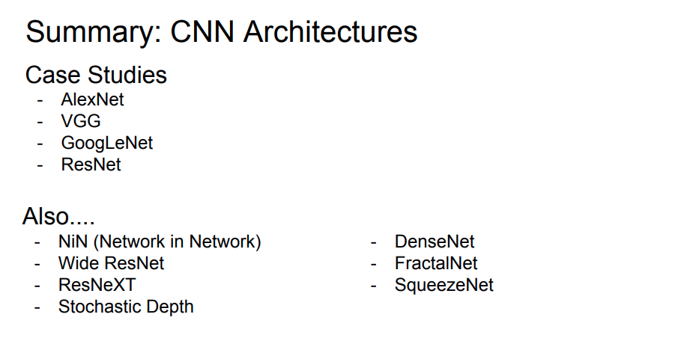
27

Slide 28
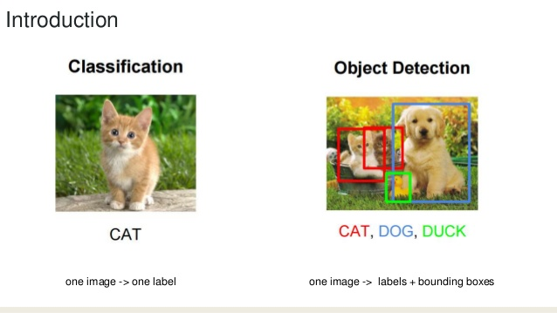
Classification VS Object Detection
28

Slide 29
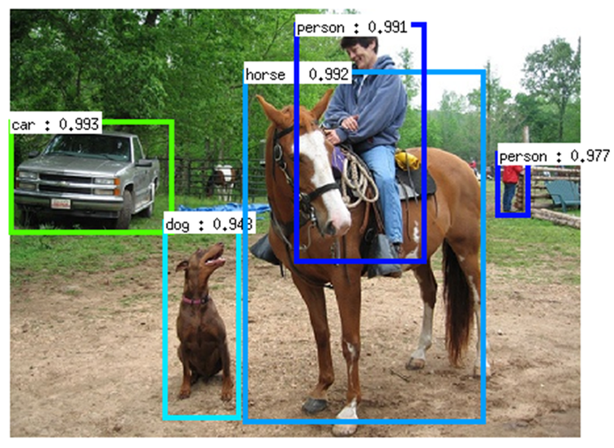
Object Detection Algorithms
R-CNN (2014)
Fast R-CNN (2015)
Faster R-CNN (2015)
YOLO (2016)
SSD and R-FCN (2016)
29

Slide 30
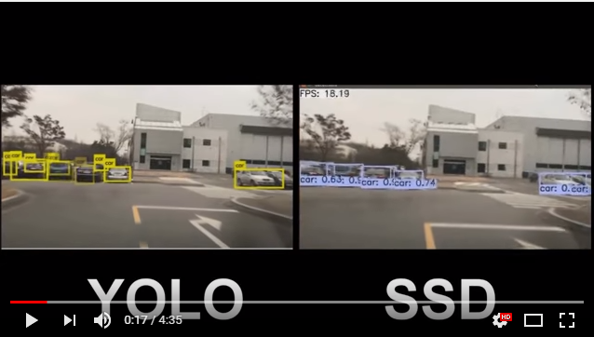
YOLO VS SSD (Off line with GPU)
https://www.youtube.com/watch?v=8QL69cAj2kU
30

Slide 31
Outline this Paper
Section 1, introduction.
Section 2, introduce the proposal layer of our object detection network.
Section 3, present the detection layer, including MPGA-based CNN and multi-frame fusion.
Section 4 Experimental results.
Section 5 Conclusions and future works.
31

Slide 32
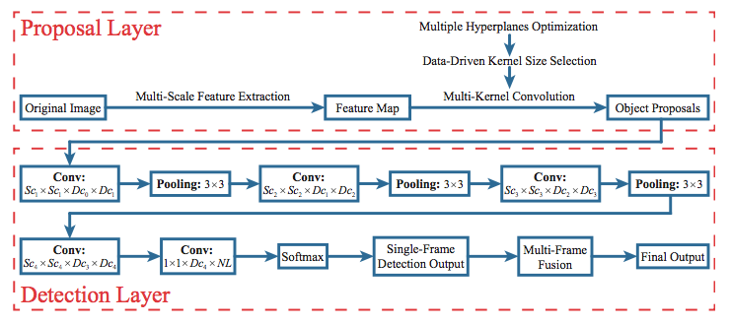
Architecture
32

Slide 33
Section 2, proposal layer (object detection)
2.1. Proposal feature extraction
2.2. Convolution-based proposal generation
2.3. Data-driven Kernel size selection
33

Slide 34
2.1. Proposal feature extraction
Inspired by Dollár [11], initially extract a set of gradient histograms as the proposal feature of the given image, which is computationally efficient and able to represent the edge and texture of an object. Instead of generating features from grey level images [12], we compute gradient histograms over RGB color images. The respective horizontal and vertical gradients of each color channel can be obtained by applying the Sobel filter [−1, 0, 1] and [−1,0,1]T on the image.
34

Slide 35
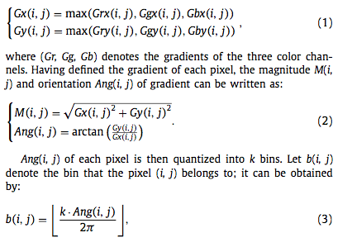
2.1. Proposal feature extraction
35

Slide 36
2.1. Proposal feature extraction
To compute the gradient histogram of each location, we divide the image into small spatial regions. A larger size of the regions will result in a lower localization precision, while a smaller size of that will lead to a higher dimension of feature vector, which will increase the computational complexity or even cause the curse of dimensionality for SVM [28]. To balance the localization precision and dimension of feature vector, we use the region size of (4× 4) for calculating the gradient histogram.
36

Slide 37
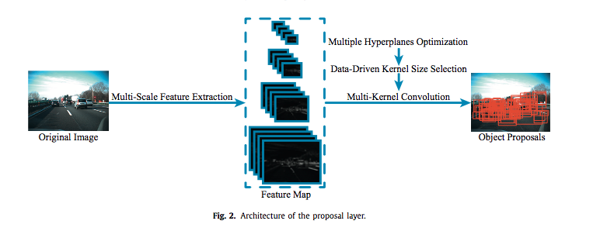
2.1. Proposal feature extraction
37

Slide 38
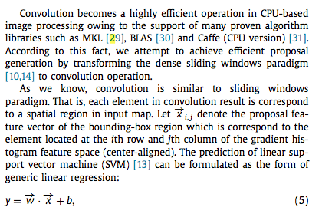
2.2. Convolution-based proposal generation
38

Slide 39
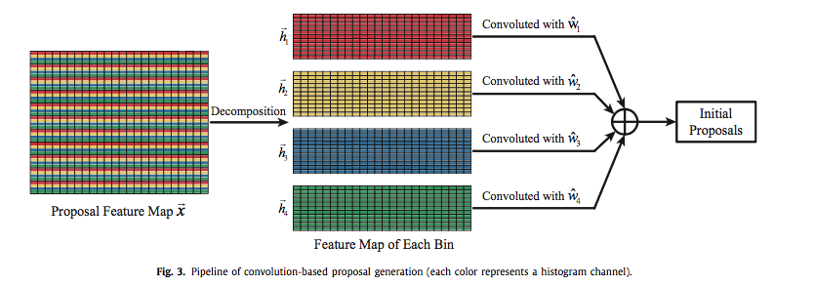
Pipeline of convolution-based proposal generation
39

Slide 40
2.3. Data-driven Kernel size selection
propose to select the size of bounding-box using a data-driven approach, which is an off-line procedure and only needs to be performed once.
We illustrate the bounding-box size selection problem using the TME Motorway dataset [3],
40

Slide 41
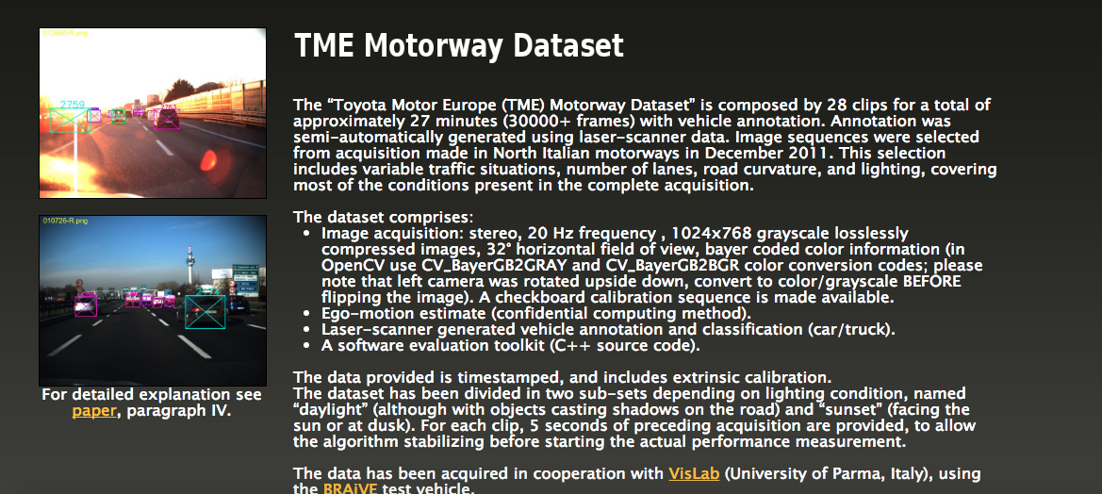
41

Slide 42
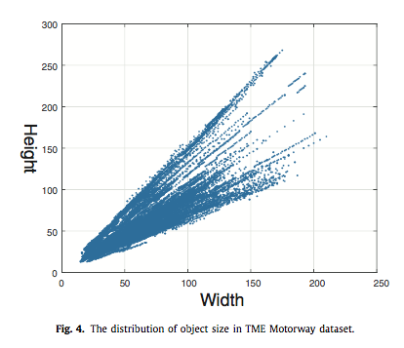
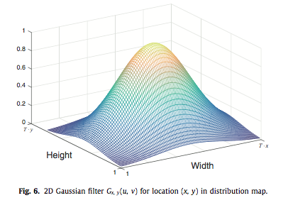
2.3. Data-driven Kernel size selection
Apply
42

Slide 43
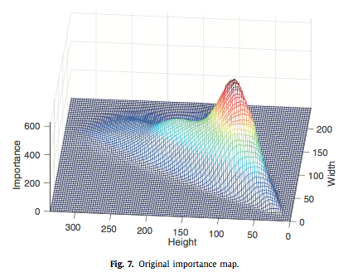
2.3. Data-driven Kernel size selection
43

Slide 44
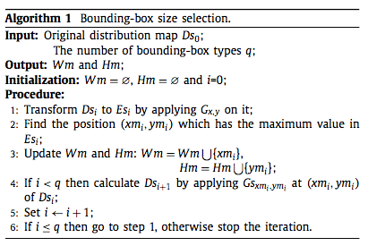
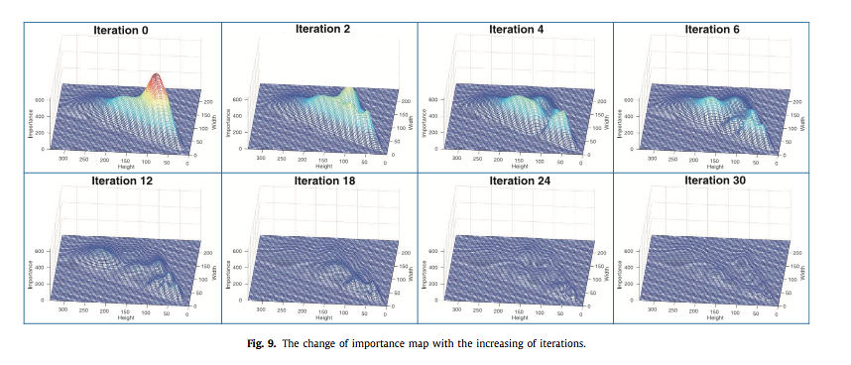
2.3. Data-driven Kernel size selection
44

Slide 45
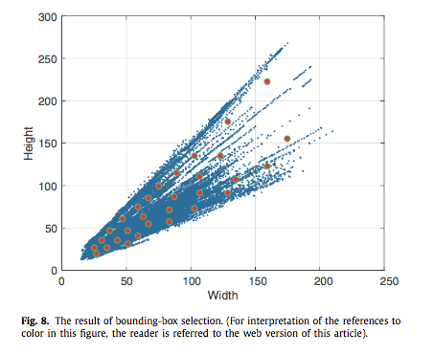
2.3. Data-driven Kernel size selection
45

Slide 46
3. Detection layer
we first propose an MPGA-based convolutional neural network (CNN) module to balance the performance and computational complexity of deep convolutional neural networks. Then, we design a multi-frame fusion strategy to utilize temporal information and improve detection performance.
3.1. Constructing convolutional neural networks using MPGA
3.2. Multi-frame fusion
46

Slide 47
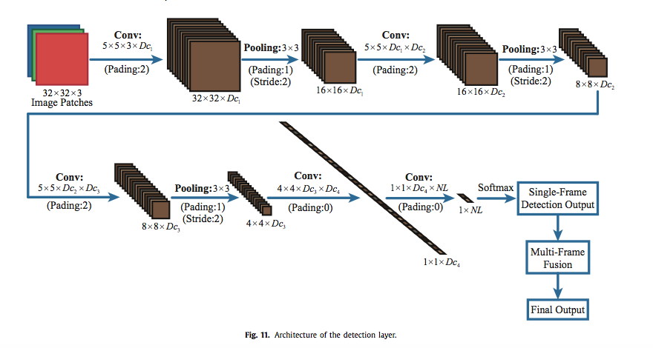
3. Detection layer
47

Slide 48
3.1. Constructing CNN using MPGA
MPGA is an optimization algorithm inspired by biology, whose object function is not required to be continuous or differentiable. Moreover, MPGA is more likely than traditional genetic algorithms to obtain global optimal solutions [41]. In MPGA, the variables that need to be optimized are first encoded to chromosomes, and then two or more populations that contain several chromosomes are generated. The populations evolve in parallel until they converge to a stable status. In this way, the optimal solutions are obtained.
48

Slide 49
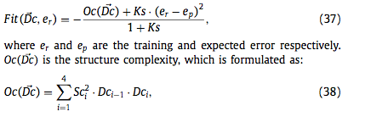
3.1. Constructing CNN using MPGA
For the optimization problem in this work, since Dc0 and D c 5 a r e d e t e r m i n e d ( s e e E q . ( 3 0 ) ) , w e fi r s t t r a n s f o r m D⃗ c = [Dc1 , Dc2 , Dc3 , Dc4 ] to binary codes which act as chromosomes of MPGA. Then Np populations are generated (each population is made up of Nc chromosomes). The fitness function F i(D⃗c, er ) of MPGA is defined as:
49

Slide 50
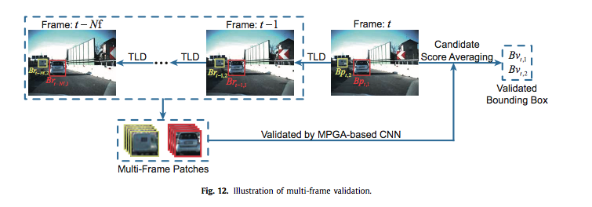
3.2. Multi-frame fusion
50

Slide 51
3.2. Multi-frame fusion
the probability of a non- object region giving a false positive in several consecutive frames is much lower than that in a single frame.
Image region is detected to be positive in several consecutive frames, then there is a high probability that the image region is an object re- gion.
multi-frame fusion can effectively improve the true positive rate and yet reduce the false positive rate. More- over, detection in different frames can be smoothed by multi-frame fusion.
51

Slide 52
4. Experimental results
4.1. The proposal layer
4.2. MPGA-based CNN
4.3. Full system
52

Slide 53
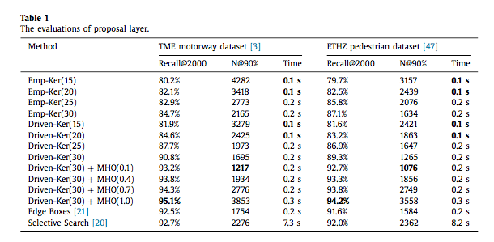
4.1. The proposal layer
laptop which contains an Intel i7-4700MQ processor running at 2.4 GHz. Except for off-line training, all the detection processes in the experiments run without GPU support.
53

Slide 54
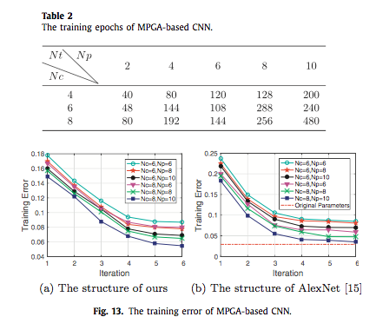
4.2. MPGA-based CNN
54

Slide 55
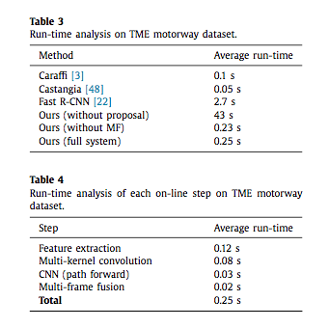
4.3. Full system
55

Slide 56
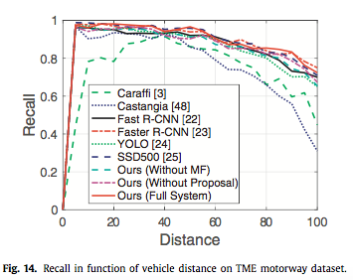
4.3. Full system
56

Slide 57
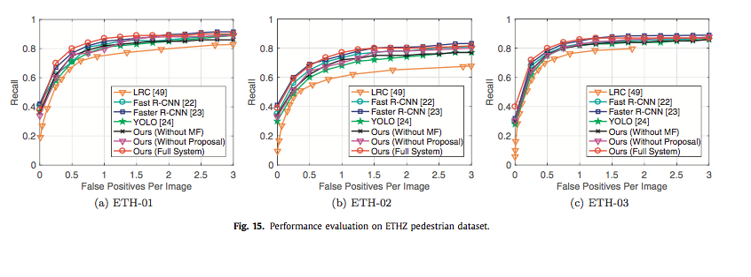
4.3. Full system
57

Slide 58
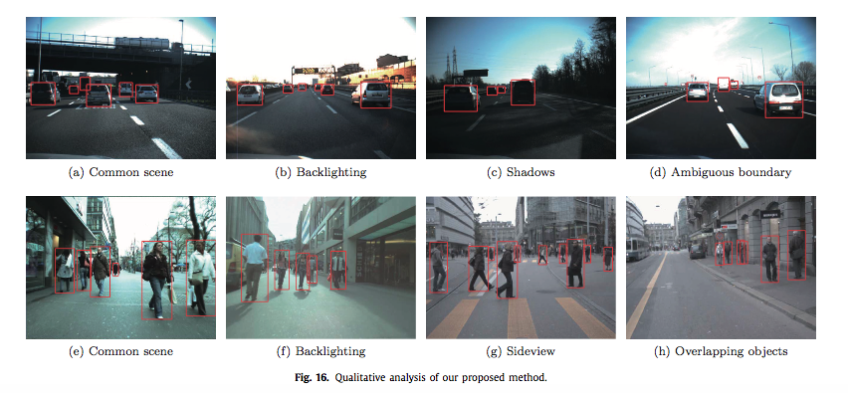
5. Conclusions and future works
In the experiments, we validate each component of our pro- posed object detection system and compare the system with some recently published state-of-the-art object detection algorithms on widely used datasets. Even under challenging scenarios with shadows, backlighting, different viewpoints, overlapping objects or ambiguous boundaries, the proposed system is proved to be both efficient and effective in object detection.
58

Slide 59
5. Conclusions and future works
the proposal layer is able to work efficiently and reliably. Then, we construct a robust detection layer which works on the proposal layer. The detection layer involves an MPGA-based convolutional neural network (CNN) and a TLD-based multi-frame fusion procedure
59

Slide 60
Reference
Keyu Lu, Xiangjing An, Jian Li, Hangen He, Efficient deep network for vision-based object detection in robotic applications (2017)
Slide CS231n: Convolutional Neural Networks for Visual Recognition http://cs231n.stanford.edu/syllabus.html
60

Slide 61

61

